Slide 1



GrocHop
Page 1
Next Slide

Slide 2

Problem
Statement
GrocHop is an online grocery and essentials delivery platform designed for a seamless and efficient shopping experience. It offers real-time stock updates, secure payment options, and order tracking to enhance reliability. Users can browse a wide range of products, add items to their cart, and place orders with ease. The platform ensures a smooth checkout process and timely deliveries, making everyday shopping more convenient. With an intuitive interface and robust features, GroChop simplifies grocery shopping, saving users time and effort.
Page 2
Next Slide

Slide 3


Proposed Project Team Members
Prachi 2210990659
Prisha 2210990682
Paras Kapoor 2210990637
Priyanshu Saini 2210990688
Total Duration of Project
200 Hours
Page 3
Next Slide

Slide 4
Technical
Nodes
Frontend
Backend
Database
Site-Management
React js
Node js
Express js
MySQL
ReduxToolkit
Navigation
Payment Integration
ReduxToolkit
Razorpay
Page 4
Next Slide

Slide 5

Foundation
GrocHop was founded with the vision of simplifying everyday grocery and essentials shopping through a seamless online platform. It offers real-time stock updates, secure payments, and order tracking to enhance reliability. Users can explore a wide range of products, add items to their cart, and place orders effortlessly. The platform ensures a smooth checkout process and timely deliveries, making shopping more convenient. With an intuitive interface and robust features, GroChop saves users time and effort while providing a hassle-free shopping experience.
Page 5
Next Slide

Slide 6
Key
Features
User-friendly Interface
Cart & Wishlist
Category Management
User Authentication
Secure Authorization
Page 6
Next Slide

Slide 7
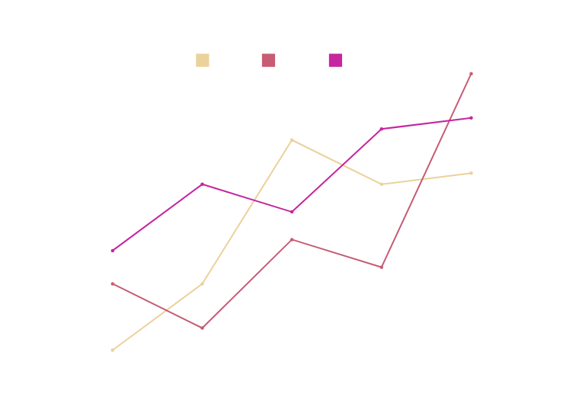
Market
Competitors
GrocHop competes with platforms like Blinkit, BigBasket, and Instamart, which dominate with strong supply chains and AI-driven services. To stand out, GrocHop focuses on seamless UX, efficient order management, and multiple payment options, ensuring a fast, user-friendly, and affordable grocery shopping experience.
Page 7
Next Slide

Slide 8
Easy Authentication
Convenient Shopping
User
Seamless login, registration, and authentication for a secure and hassle-free experience.
Users can browse, add to cart, and place orders effortlessly with a smooth interface.
Benefits
Secure and Reliable Platform
Multiple Payment Options
Ensures safe transactions and data protection, providing a trustworthy shopping experience.
Secure transactions with UPI, cards, and net banking for a flexible checkout experience.
Page 8
Next Slide

Slide 9
Order History & Reordering
Wishlist Feature
Allows users to save their favorite products for future purchases, making it easier to reorder essentials quickly.
Upcoming
Users can view past orders and quickly reorder their favorite products.
Features
Password Change
Order Status Notifications
Allows users to securely update their account password to maintain account privacy and security.
Real-time updates on order confirmation, dispatch, and delivery.
Page 9
Next Slide

Slide 10
Thank
You!
Page 10
Next Slide

